Slide 1
From office design to soundscaping
Philip Vanhoutte
Championing Smarter Working

Slide 2
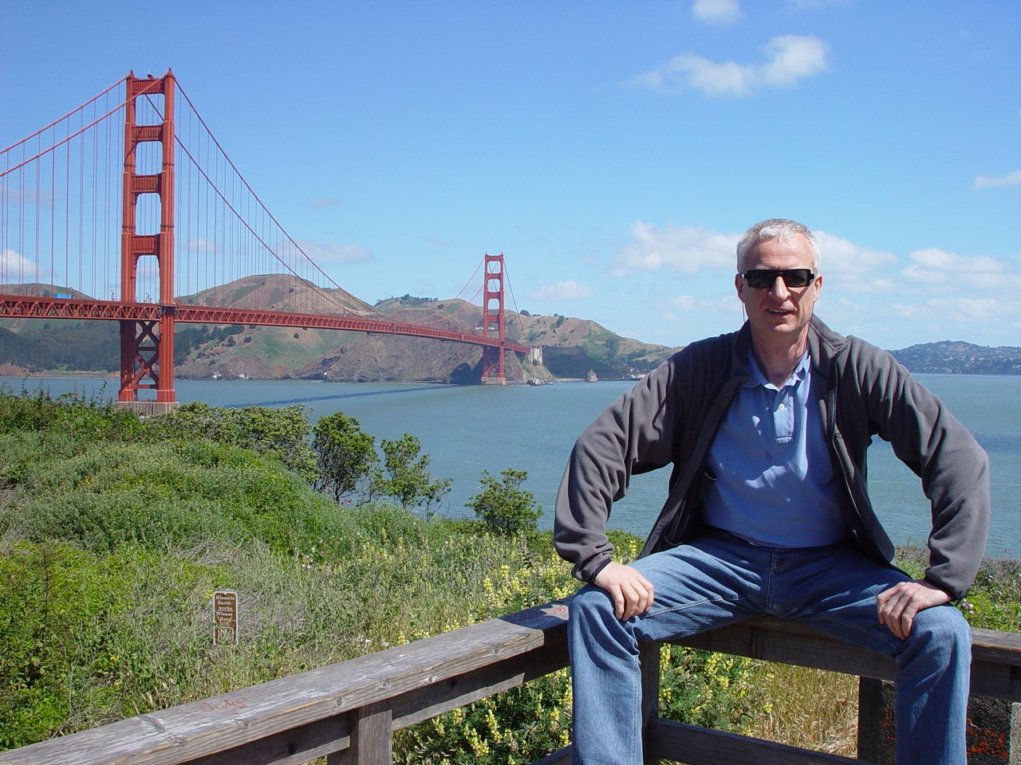
About our Presenter
Commercial Engineer, Marketing, Leuven, Belgium
Married to Rose-Mie; Sons: Piet 35 (Texas), Jan 32 (London), Grandson Pierson 1
Lives in TUMI-land, primary bed near Amsterdam
Accenture, Wang, Nokia, Fujitsu-ICL, Dell, WorldCom, Sony-Ericsson, Plantronics
Philip
Vanhoutte
Your role
Your background
Photo

Slide 3
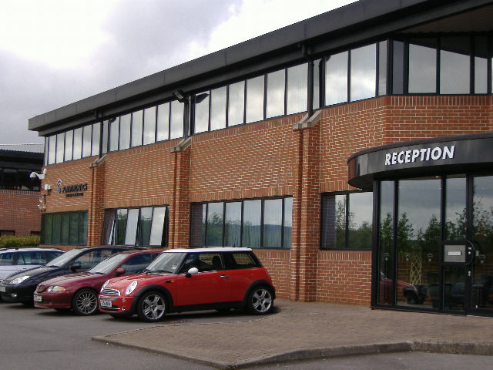
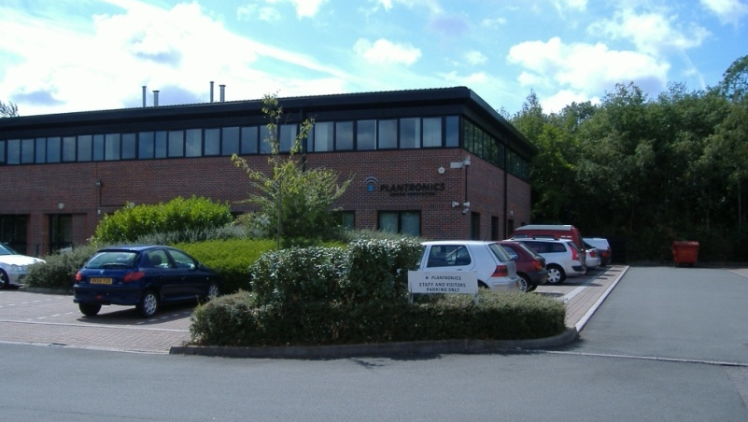
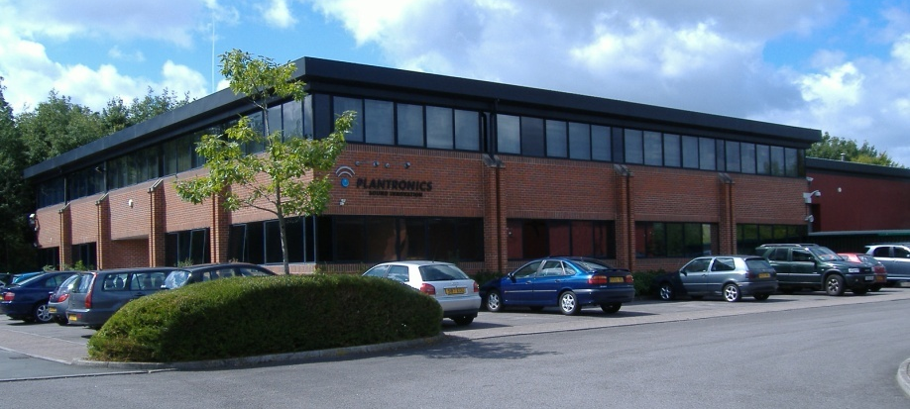
Aligning the Workplace to the Business
Economic
Crisis !
Rationalization
Building
Collapse
3 into 1

Slide 4
Holistic Human Centered Work Design
Integrated Multi-Disciplinary Smarter Working Implementation
“Bricks”
Work Topology
For Smarter WorkSpaces
“Bytes”
Mobile Unified Communication & Collaboration
“Behaviour”
Virtual Professionalism
Allowing associates to work where & when they are most productive, cost-effective and environmentally respectful.

Slide 5
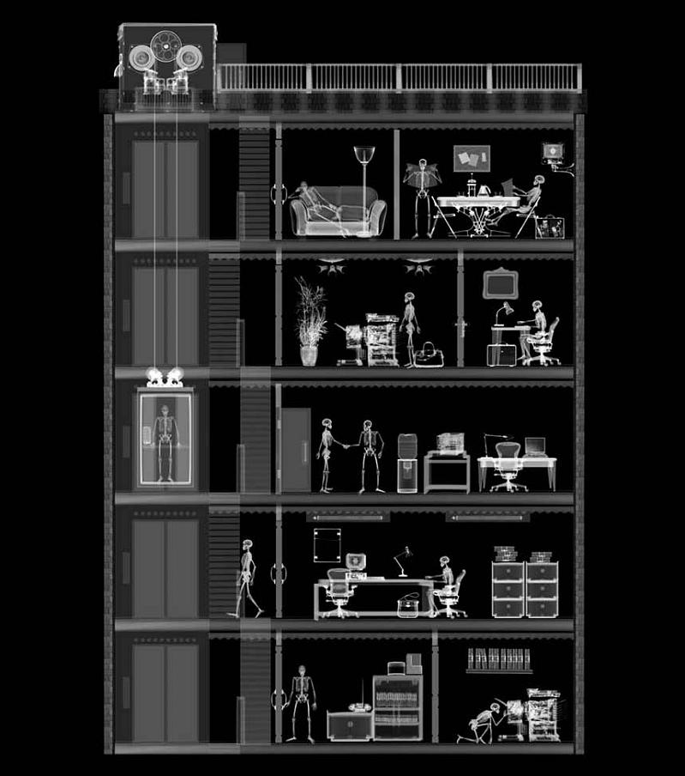
Associate WorkSpace Satisfation Survey
Notes:
The result is a x ray of the workplace. That enables you to see what’s going on inside. But Leesman, like the radiographers in medicine, then steps back, passing the x-ray to expert clinicians

Slide 6
Lowest performing WorkSpace: satisfaction Lmi 33.3 “Which activities are important to you in your work, and how well are they supported?”
leesmanindex.com
@leesman_index
Notes:
This is the activity analysis of the organisation where just 15% of employees say they can work productively

Slide 7
Acoustic Zoning
Collaborate
Group discussions
Concentrate
Contemplate
Taking time out
Communicate
Mixture of face-to-face and virtual collaboration / communication
Brainstorming sessions
Formal meeting area
Stimulating
Comfortable
Re-energizing
Presentations
Audio / video conferencing
Private
Fixed or flexible desk space
Superb acoustic shielding
Focused individual work
Quiet, enclosed space

Slide 8
The new Communications Gearbox
Presence
Five Speeds
Get attention via Instant Message
Click to talk with Smartphone or PC
Invite more to audio-conference
add video for extra dimension
overdrive into TelePresence

Slide 9
Acoustic Intelligence
Tune your
Voice Power
Voice is critical for
Dispersed Working
Speech Impact
Voice Intelligibility
Audio Ergonomics
Speech Impact
Voice Intelligibility
Audio Ergonomics
Noise/Wind
Reduction
HD
Voice Networks
Designed for
Fit & Looks
Protect
Ears & Voice

Slide 10
Impact to the Business
Diminished absenteeism by 60%
Reduced real-estate costs by 30%
Increased productivity by 20%
Increased customer & employee satisfaction by 10%

Slide 11
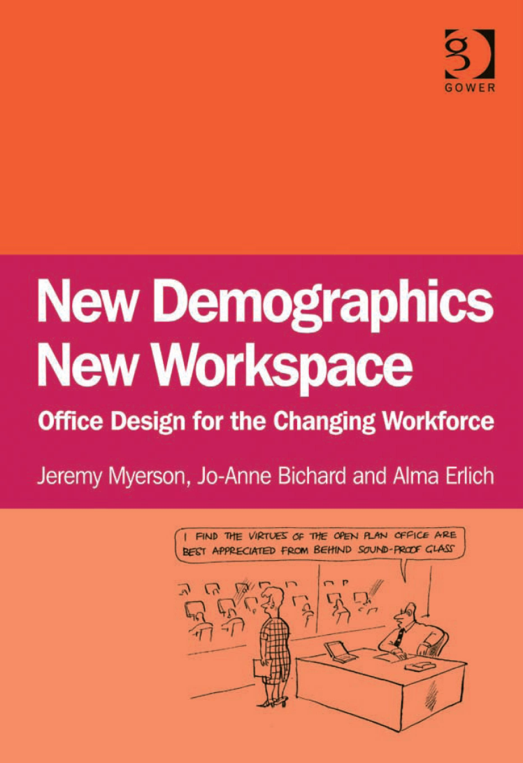
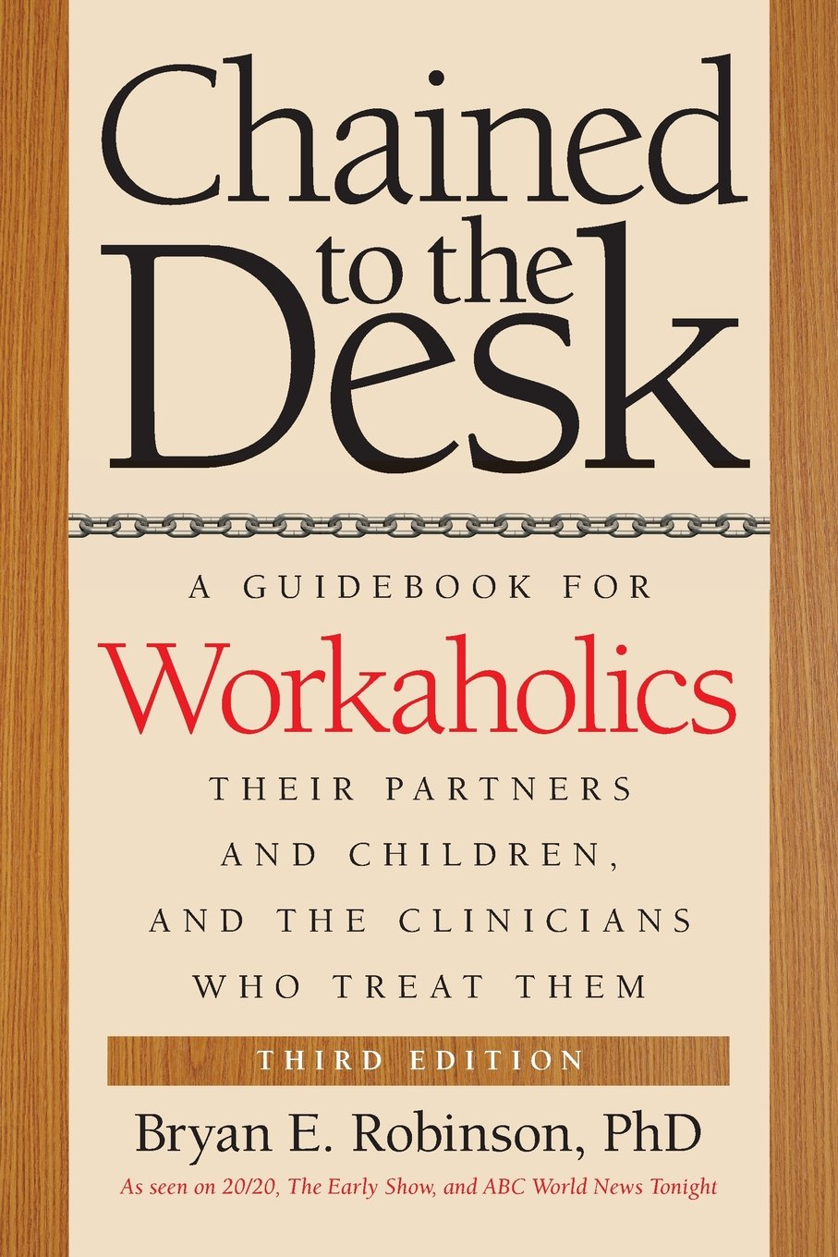
Top Challenges
Work Intensification
Noise = Biggest Bugbear

Slide 12
Key Learnings
Leadership in Transition to Smarter Working
Multidisciplinary Project – IT, Space, HR
The Duty of HR = Human Realization
Acoustics is MEGA important
THE BENEFITS ARE ENORMOUS
Distributed Working: don’t overdo it !

Slide 13
Questions?

