Slide 1

National Equity Fund
And They Said It Couldn’t Be Done
Gaylene Domer
October 5, 2016

Slide 2
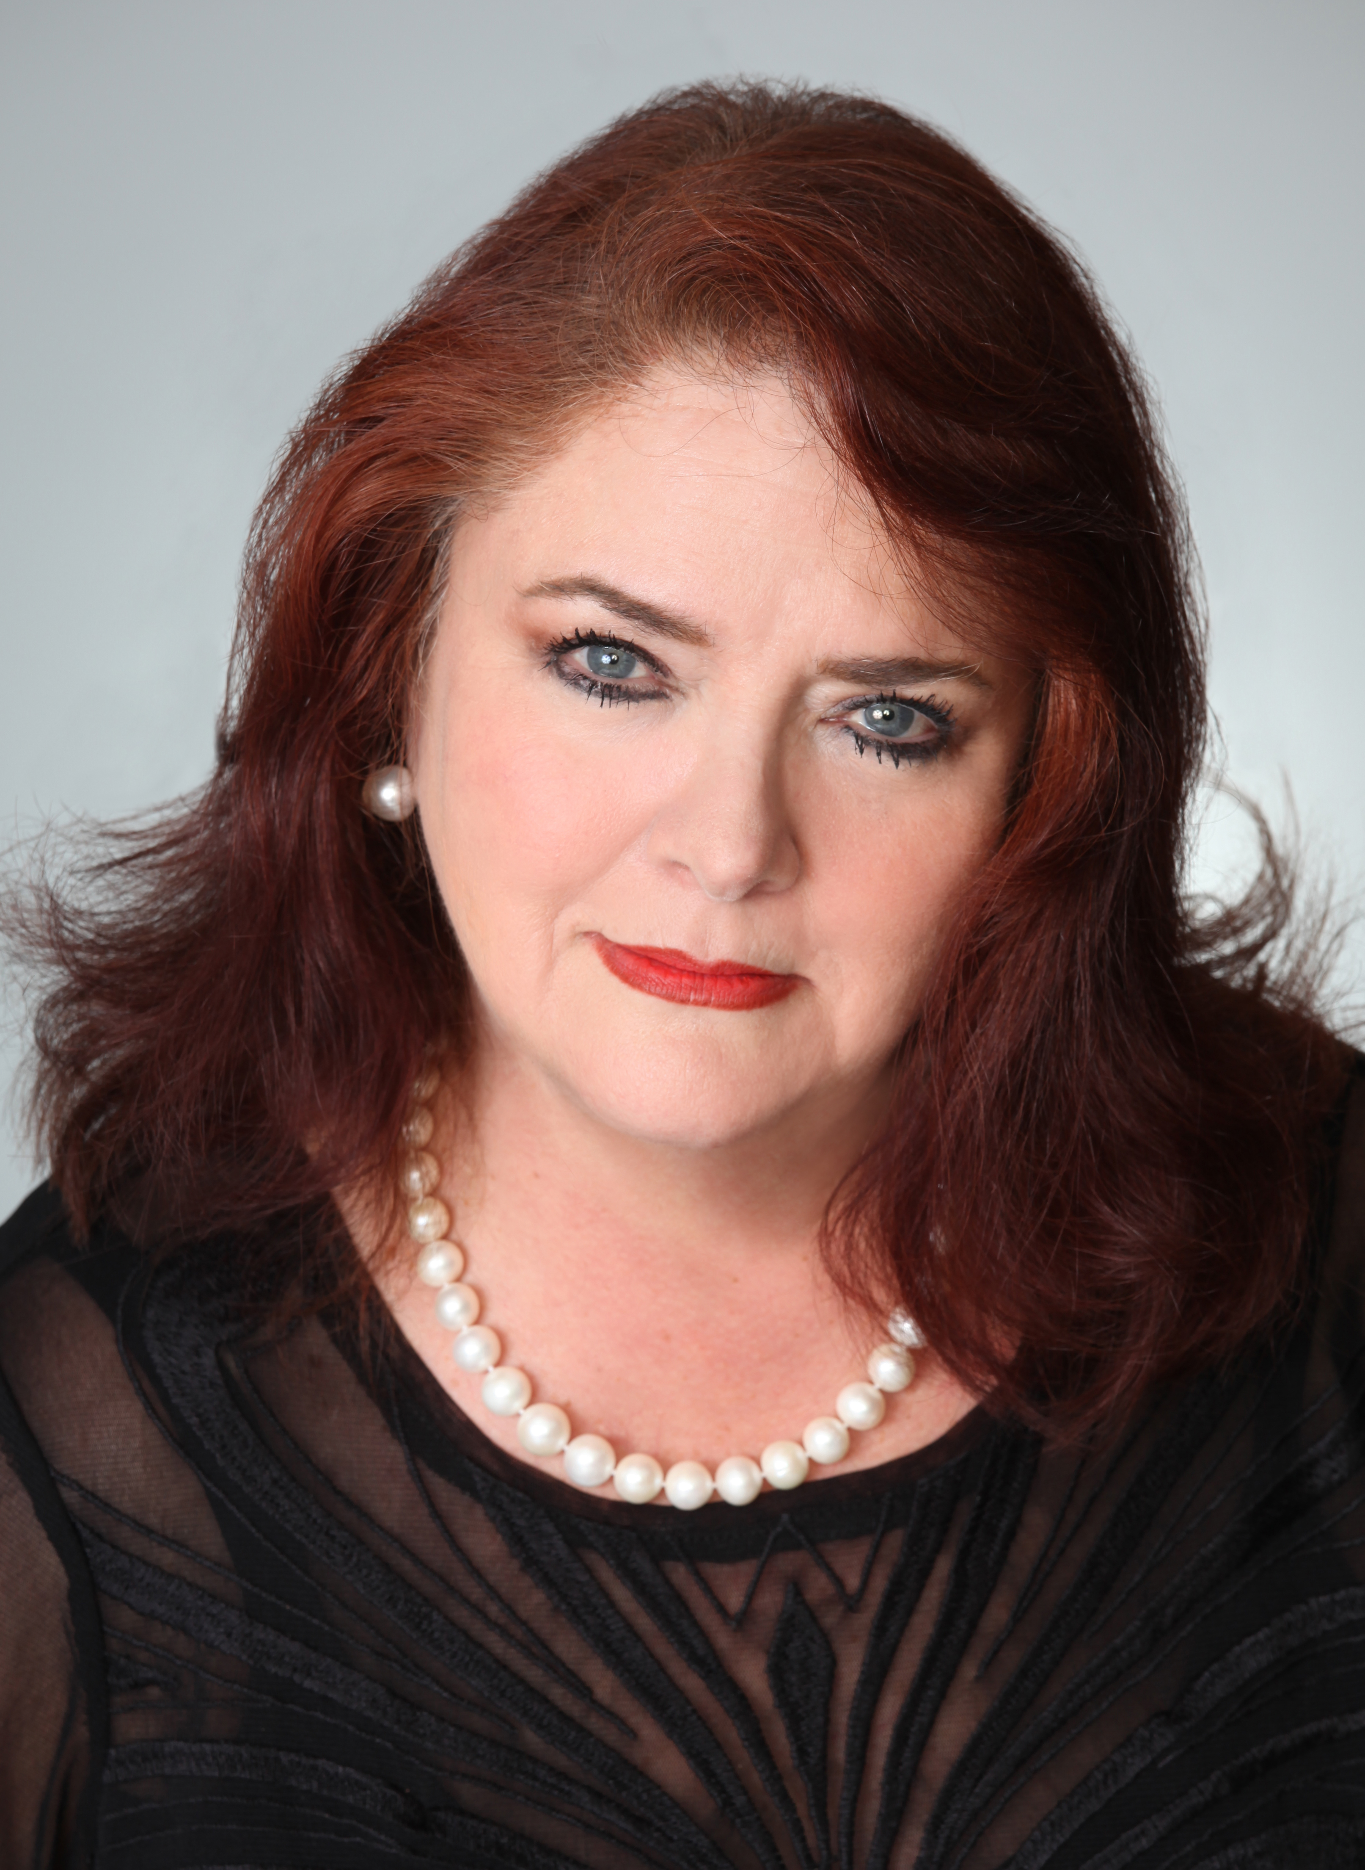
Gaylene Domer
Vice President Facilities
Management
NEF employee 29 years – oversee $3.1 million dollar budget – manage 18 field offices – implementation of a new WFH program – head of office/operational procedures – workplace strategy and support culture/employee satisfaction
photo

Slide 3
ALIGNING THE WORKPLACE TO THE BUSINESS
National Equity Fund – Leading syndicator of low-income housing tax credits with 167 employees and 18 offices
Changed the corporate culture
Improved communication
Instrumental in attracting and retaining talent
Aligned the C-suite with IT, HR and Facilities
Installation of new SMT System and new technology

Slide 4
YOUR PROCESS
Began the relocation process making a case for CHANGE... I developed and used daily my creation of the “FM” Guide Book entitled, The NEF Change Project. C-creating new modern space... H-healthy outlook on work-life balance... A-architecturally unique and cutting edge...N-new way to work... G-generational demographic motivators... E-environmentally conscious and sustainable new space. Developed training programs for the new technology

Slide 5
IMPACT TO THE BUSINESS
Aligned the C-Suite, RE/Facilities, IT and HR
Reduced square footage by 7,000 sf
Saved 2.4 million over the term of the lease
Introduced a Work From Home program
Eliminated over 9 tons of paper (weight of a large elephant)
Employee satisfaction and engagement changed the culture
Introduced dynamic and cutting edge technology to enhance NEF’s position in the marketplace

Slide 6
MANAGING METRICS
On-going surveys for distributed workforce participants
Training Thursdays-technology training to enhance productivity
Looking for ways to change/improve space utilization to keep pace with changing needs of the company
Keeping at the forefront NEF’s green program and looking for options to offer wellness programs
Attend as many IFMA/WE events as possible each month to stay current

Slide 7
KEY CHALLENGES
Getting the CEO, senior staff and the Board of Directors convinced was not all that difficult
Figuring out the logistical strategy of how to introduce a new WFH program and at the same time manage and execute a major relocation project was the most challenging task
The biggest personal challenge was to stay calm, muster up nerves of steel and learn the patience of a saint

Slide 8
KEY LEARNINGS
Don’t ever take this kind of risk... as described in the previous slides... unless you have an expert at your side with hands-on experience to help guide you through the process
Any relocation project is a major undertaking; but adding at the same time, a complete shift in an organization’s long-term work routine is bigger than big; it is HUGE
The “key” to NEF’s success was the staff; they were instrumental in making it work

Slide 9
QUESTIONS & COMMENTS
And They Said It Couldn’t Be Done
Gaylene Domer
October 5, 2016

