Slide 1
Customer Service: Who’s Responsible?
Becky Huckaby, APR @AirportPR
Vice President of Public RElations

Slide 2
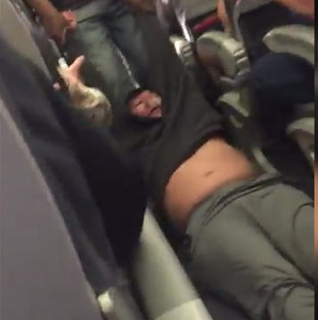
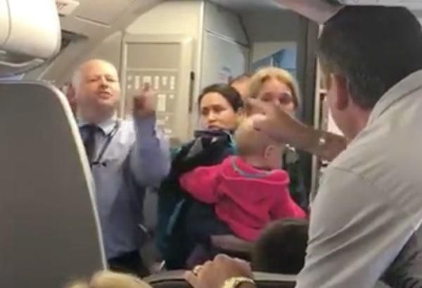

Slide 3
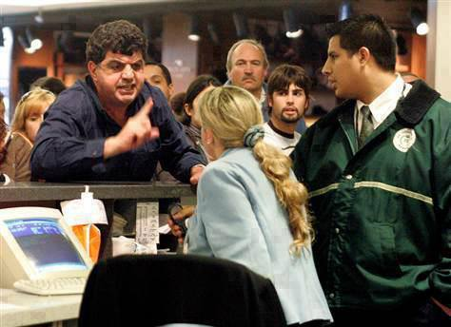
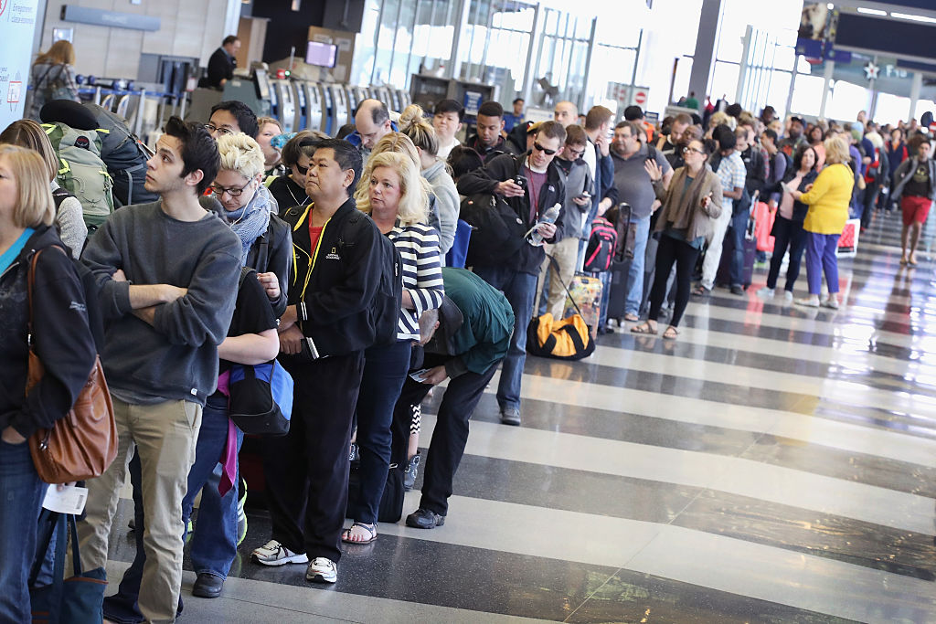
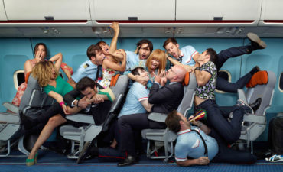

Slide 4
Clean
Friendly
Touchpoints We Control
Efficient
Amenities

Slide 5
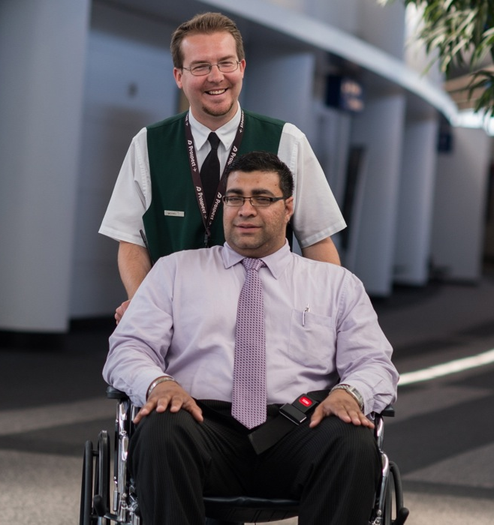
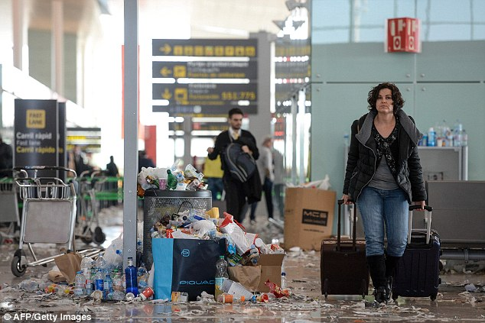
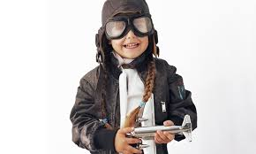
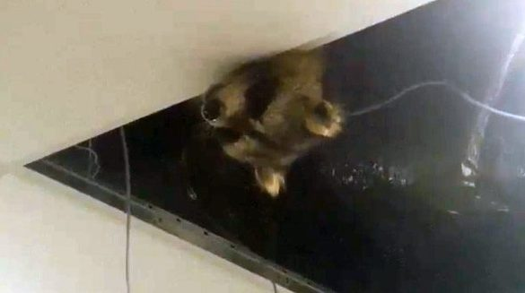
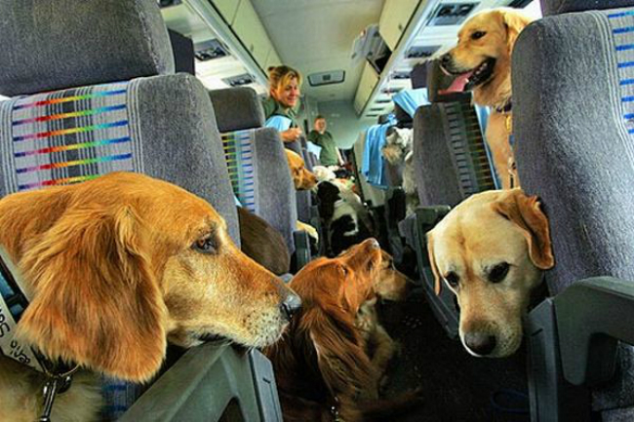
Perception of Your Airport

Slide 6
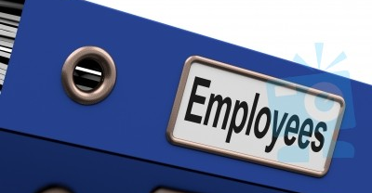
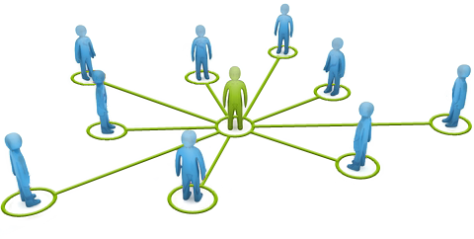
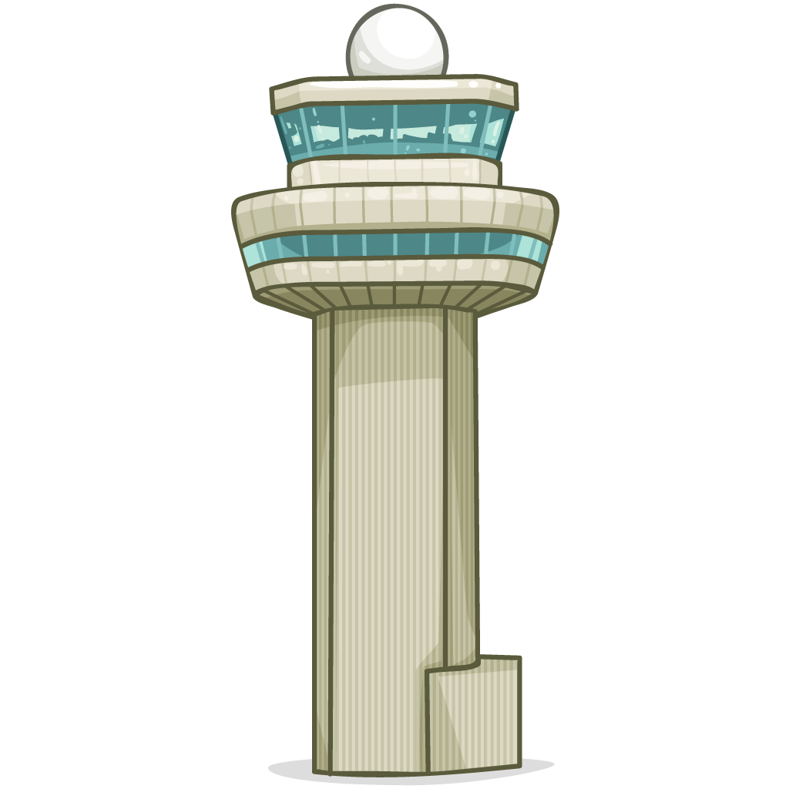
Customer Service: Facilities

Slide 7
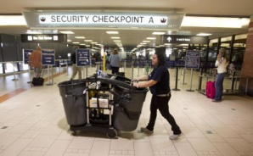
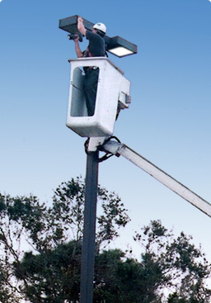
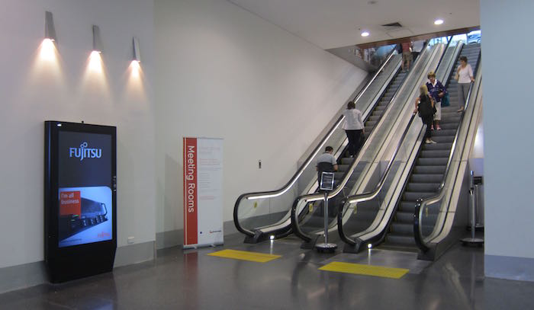
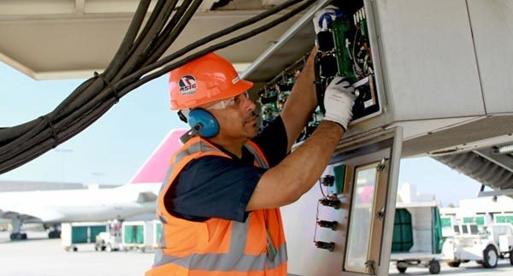
Customer Service: Facilities

Slide 8
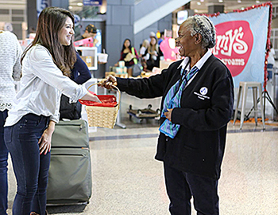
Customer Service: Communication
Be Accessible
Learn More About Your Airport
Don’t Over Promise
Always Do What You Say You Will Do

Slide 9
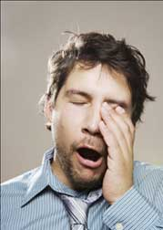
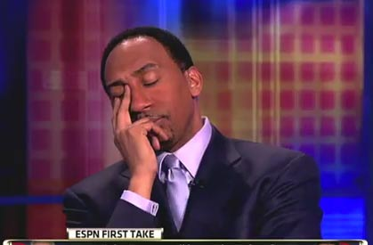
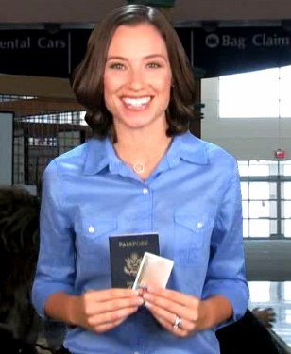
Customer Service: Body Language

Slide 10
Customer Service: Avoid Negative Statements
“The elevator is always down. You would think they would actually fix it.”
“We’ve reported to the airport but they don’t do anything about it.”
“That’s not my job.”
“I would never rent from Hertz. They have dirty cars.”
“Don’t fly with United. They will lose your bag or you will miss your connection. They are never on time.”

Slide 11
Customer Service: The Close
“Fine. Don’t fly with us anymore.”
“Good luck with that.”
“My supervisor’s number is….”
“Have I answered all of your questions?
“Is there anything else I can do for you today?
“Thank you for flying through our airport.”

Slide 12
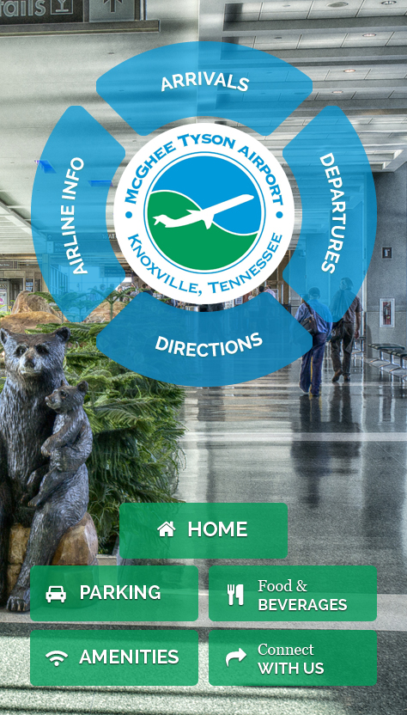
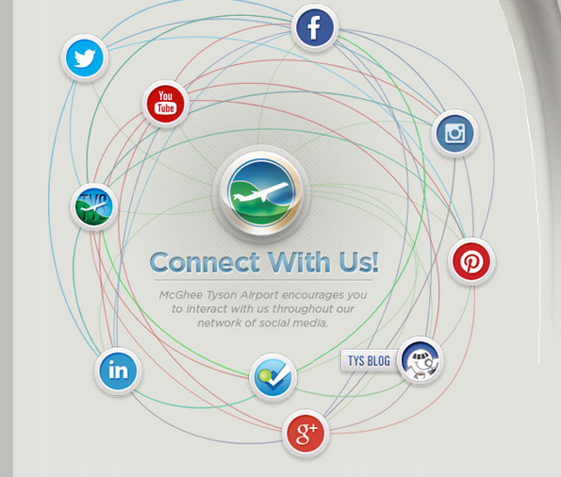
Customer Service: Help Them Help Themselves

Slide 13
Customer Service: CARP Method
Control
Acknowledge
Refocus
Problem-solving

Slide 14
Thank You For Your Time
Questions?

