Slide 1


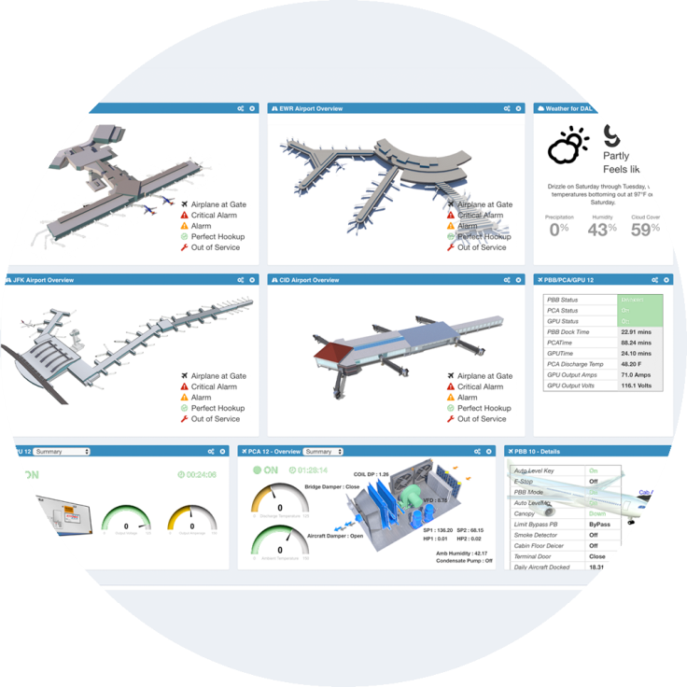
Powered By
Airport Equipment Condition Monitoring Systems
Intelligent Equipment Management – IoT
Keith Carman – JBT Airport Services
May 2017

Slide 2
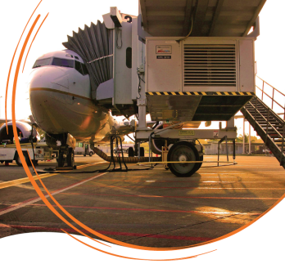
Powered By
Visibility, Knowledge, Control
Real-Time condition monitoring of equipment can make a huge difference to the bottom line by delivering operational/actionable intelligence.
A Few Advantages of Having Real Time Information:
- Immediate notification of equipment availability & malfunctions to reduce delays
- A Single version of the truth to settle disputes, confirm system operations events and their history
- Placing critical information in the hands of the right people for actionable results
- Interface with EAM/CMMS systems to transform PM program based on equipment utilization vs. calendars

Slide 3


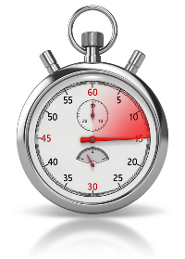
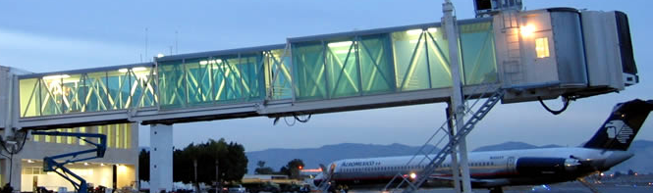
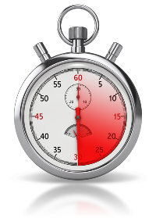
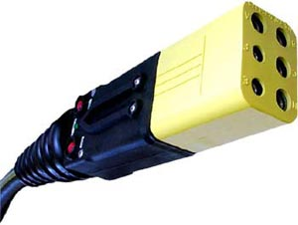
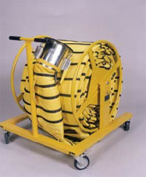
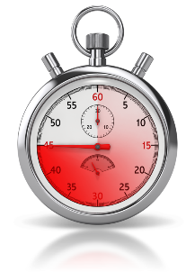

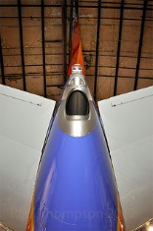
Real-Time Performance
( 0 ) Chocks On
(60 Sec) PBB Docked
(120 Sec) 400hz
(180 Sec) PCAire
(180 Sec) APU Off

Slide 4
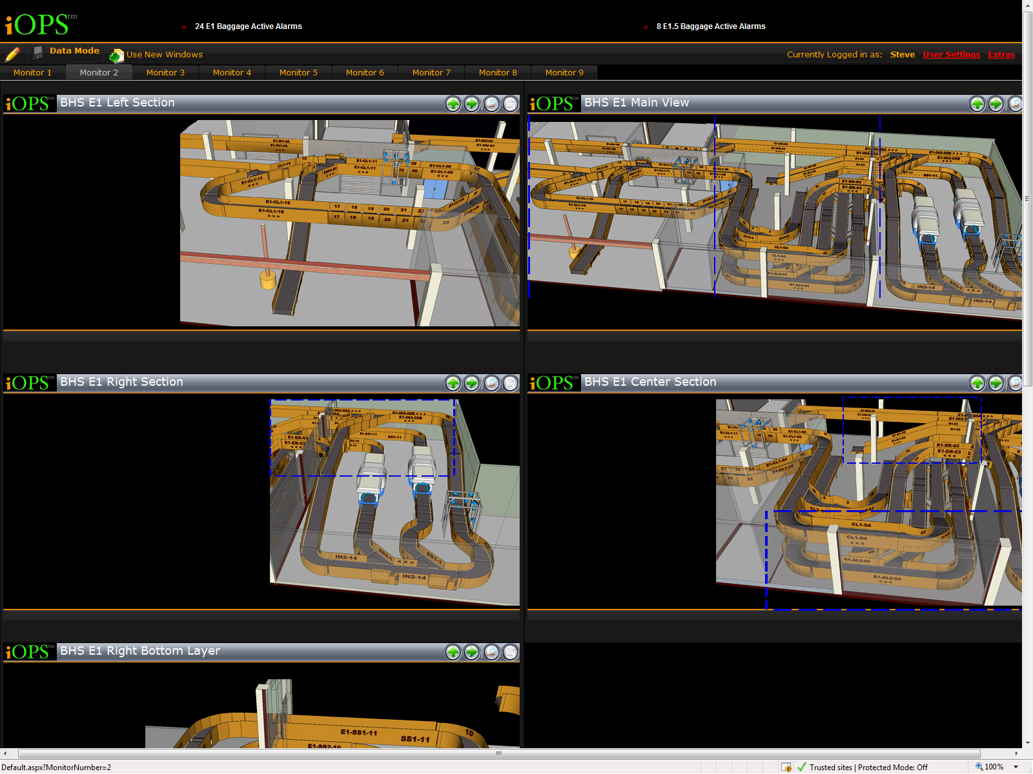
BHS Monitoring / Control
This is an example of a Bag System Monitoring Screen.
Notice everything
is drawing to scale and in 3d.
This helps the end user see the actual system.

Slide 5
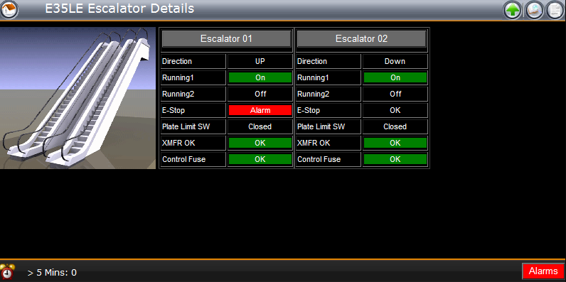
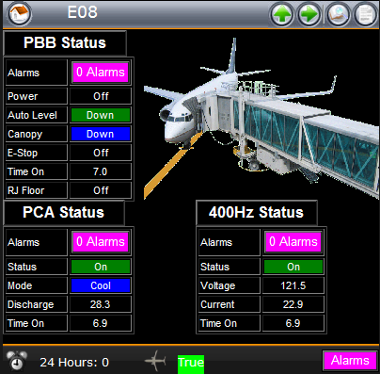

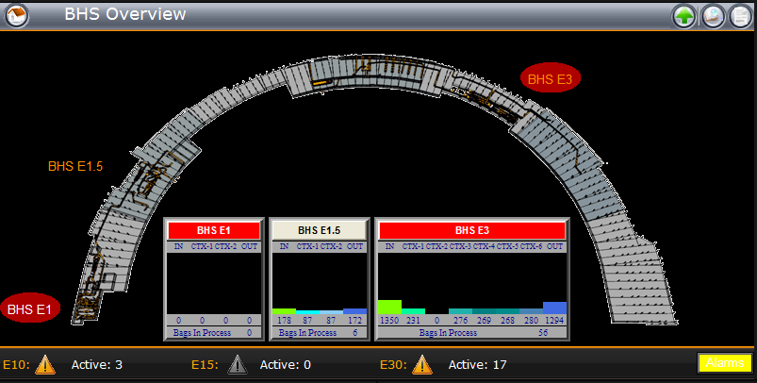
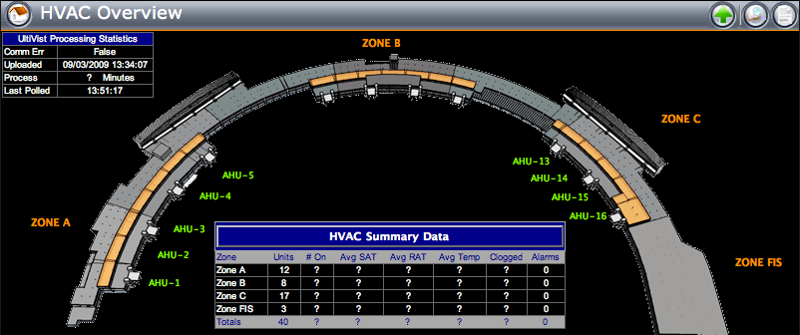
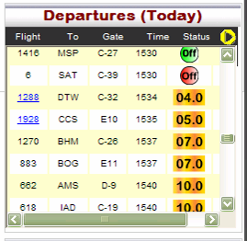
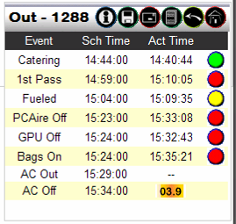
Comprehensive Monitoring / Control
Numerous in-depth statistics with drill down capability included with each overview
Plus Flight Information

Slide 6
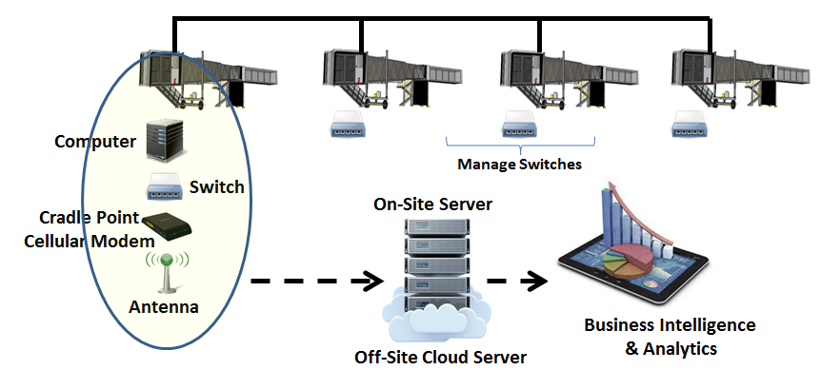

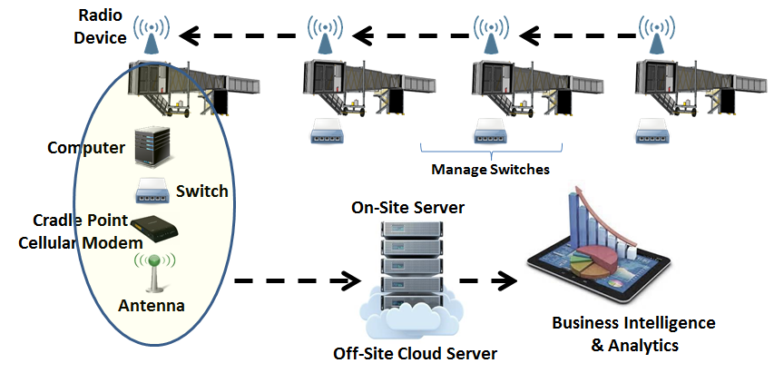
Typical Gate System Implementation
Powered By
Hardwire Application
Applications are self-hosted on-site server or off-site cloud server
=
Wireless Application
Database
Management
Data Mining & Analytics

Slide 7
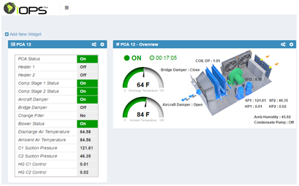
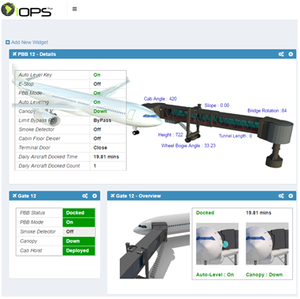
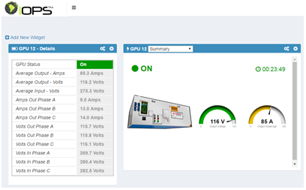
Powered By
Dashboard Configuration
PCA Dashboard
PBB Dashboard
GPU Dashboard

Slide 8
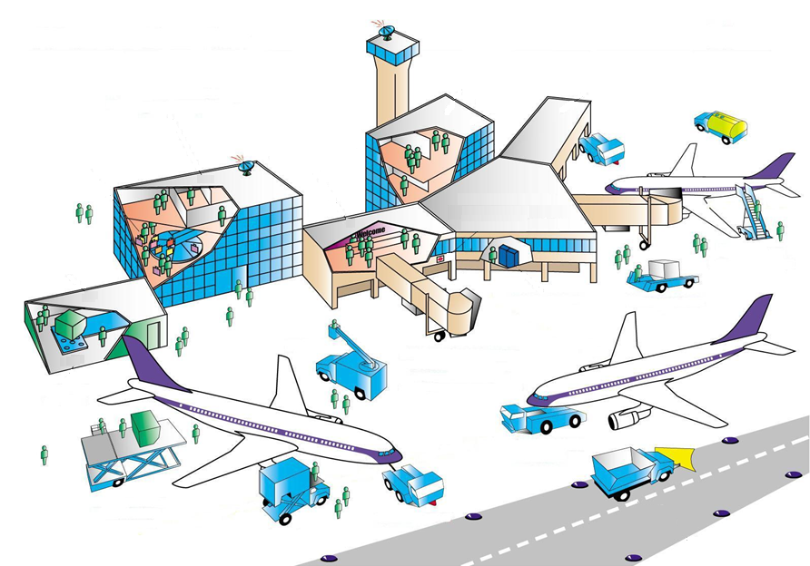
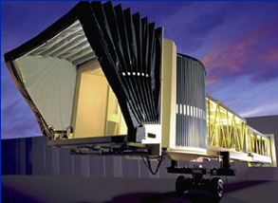

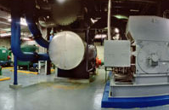
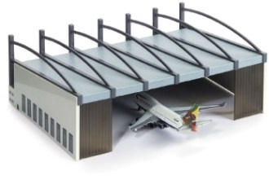
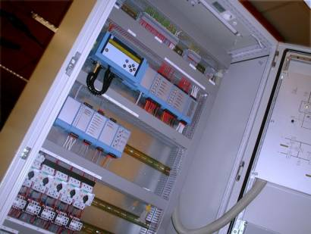
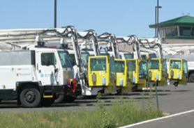


Powered By
Solution Deployment to The Enterprise
Gate Management
Terminal Management
Central Plant
Hangar Management
Baggage Systems
Building Management
Fleet Management
Ramp Equipment
EAM/CMMS

Slide 9
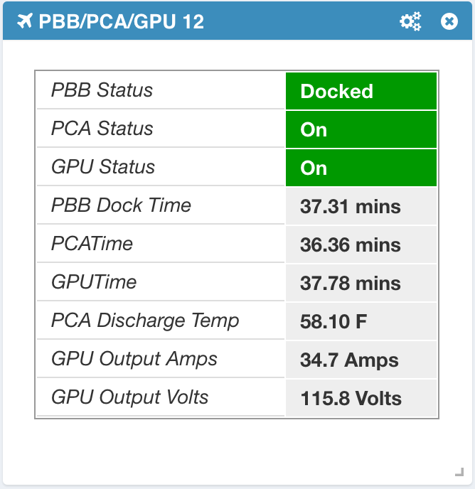
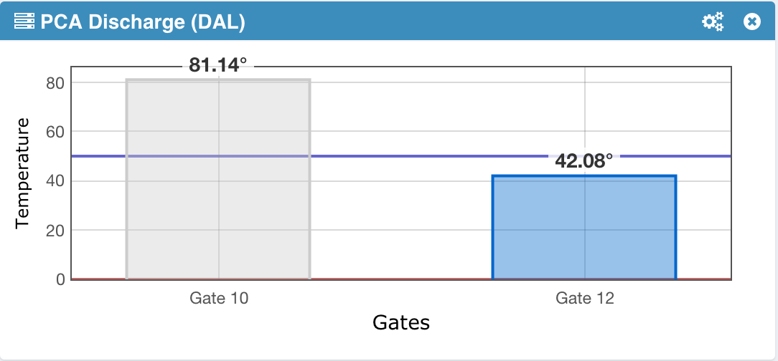
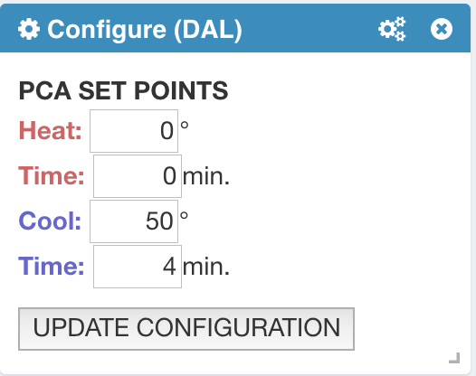
Powered By
Examples of Intelligent Data
Gate Summary Report
PCA Discharge w/ Advanced Notification
Advanced Notification
PCA Set Points for Advanced Notification

Slide 10
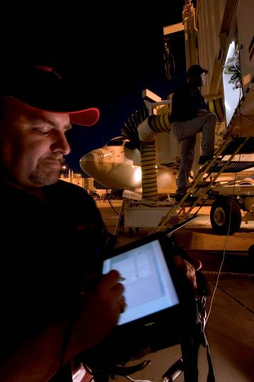
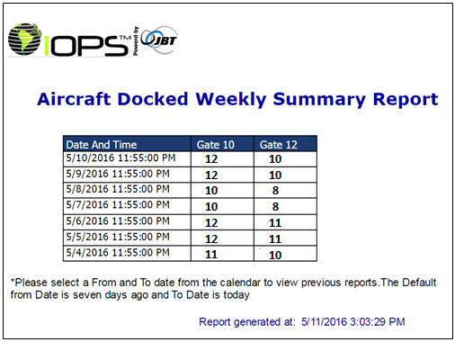
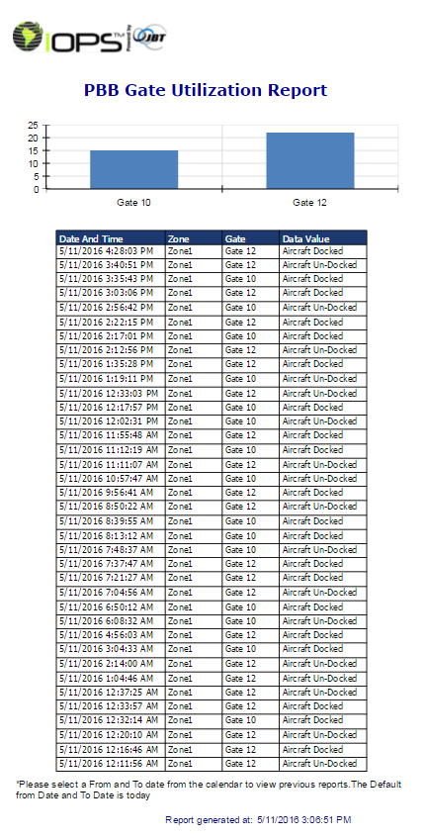
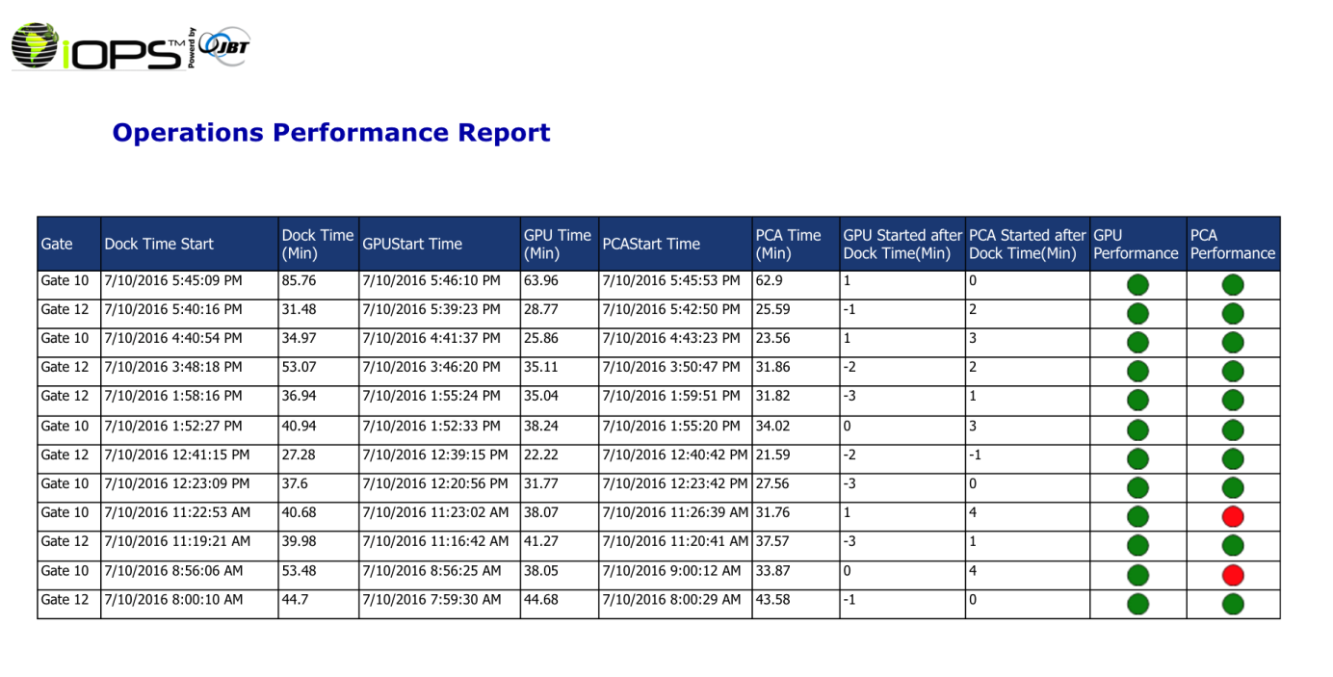
Powered By
System Reports
Configurable automatic report generation

Slide 11
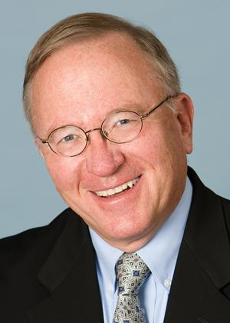
Powered By
Voice of the Industry
“In the future, the difference between excellence and mediocrity in airport operations will be the ability to dynamically track, manage and control all aspects of the operation. The iOPS system represents the technology that successfully achieves these goals.”
Michael Boyd is president of the Boyd Group and is a well known expert in futurist aviation issues, and is often called upon by the national media to provide input regarding events and trends affecting airlines, airports, and aircraft manufacturers.

Slide 12

Powered By
“When Results Matter…”
Thank You !
Questions ?
www.jbtc.com

