Slide 1
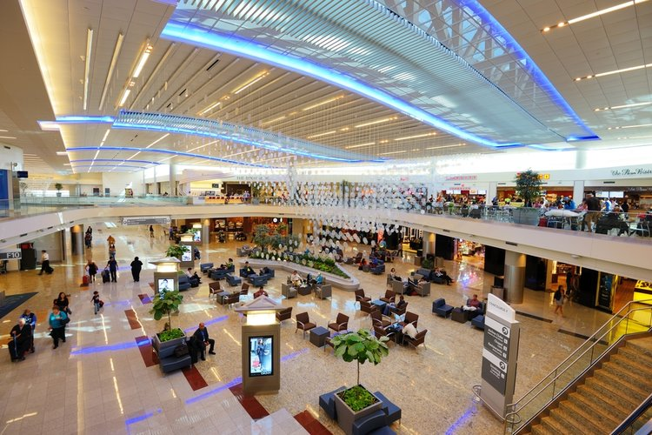
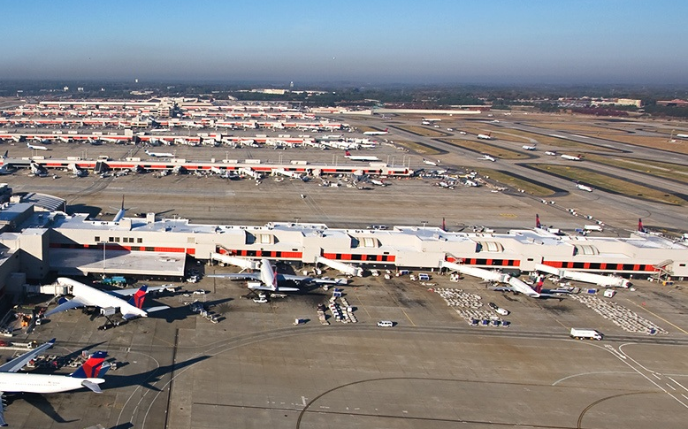
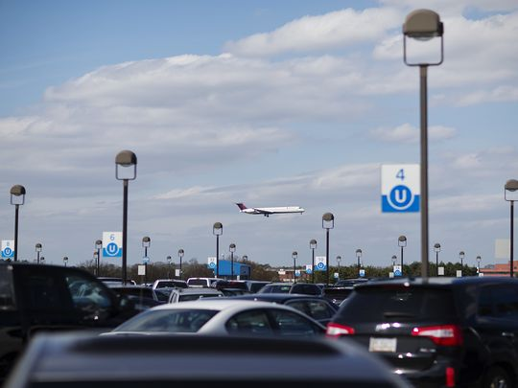
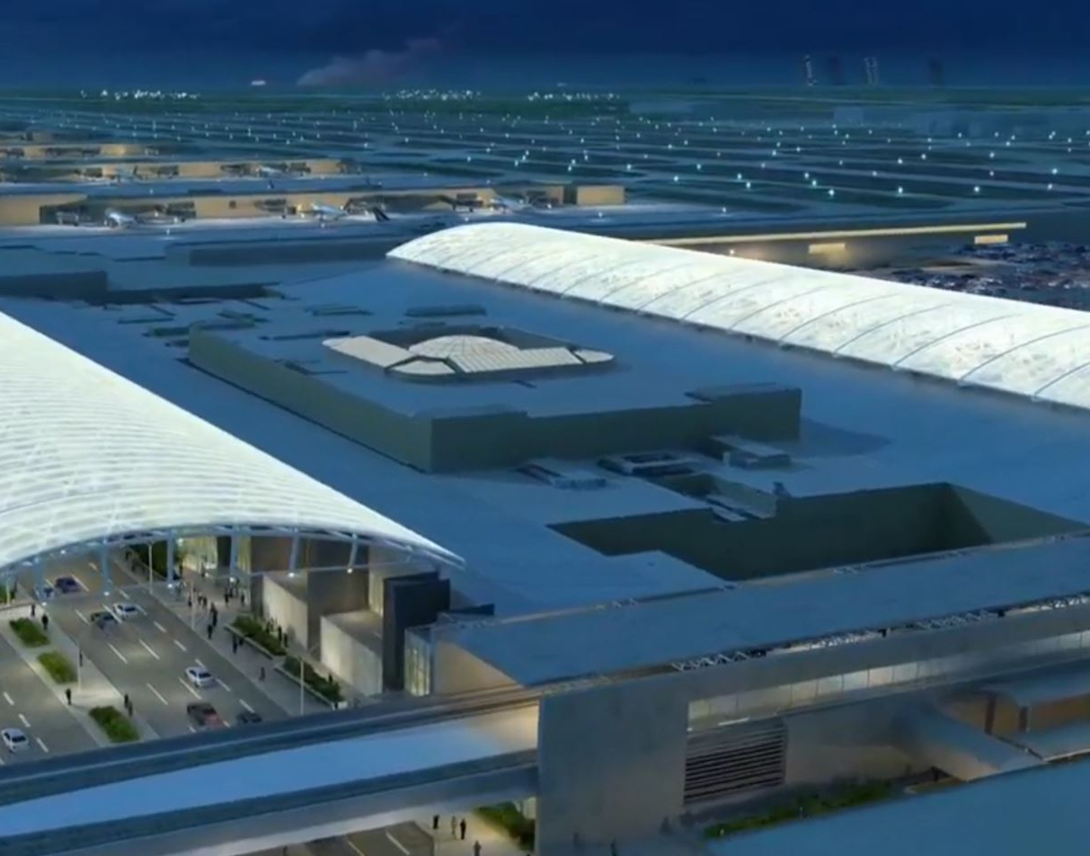
DOA Facilities Management
Airline Industry Growth Trends
April 3, 2018
Notes:
Fuel Farm Operational Headcount Transfer to Facilities Management for Future Management, Reporting and Accountability

Slide 2
State of The Industry
Domestic Growth
International Growth
Network Airline Growth
Value Airlines Growth
17 Straight “Profitable” Quarters of Growth

Slide 3
Market Segmentation
Value Carriers
Allegiant
Network Carriers
Alaska/Virgin America
Frontier
JetBlue
Southwest
Spirit
American
Delta
Hawaiian
United

Slide 4
Results
Measurement | Value Airlines | Network Airlines
2017 Carrier Yield Performance
Carrier Yield 2017 Increase | $126 Million | 634 Million
Carrier Capacity Growth 2017 | 7.2% | 2.4%
Operating Margins
Operating Margin | 20% | 20%
Unit Cost Rise (due to increase fuel cost and wages) | 4.5% | 6.1%
Incremental revenue (created by increasing seats and routes | $531 Million | $609 Million
Improvement over past years
Cumulative Losses from Yr. 2000 to 2014 | $29 Billion | $29 Billion
Capacity Increases
Domestic Capacity Increases 2017 | 9.0% | 7.2%
Biggest gain on flight departures were from China | 1.7 Million | 1.7 Million

Slide 5



World Growth Picture
China
Asia
Europe
Steadily Increasing Demand Driving Higher Capacity, Seats & Revenue
Hot Spots for Air Travel | Results
China’s Growth since 2008 | ASM Growth has jumped 153%, CAGR has averaged 10%/yr.
ASIA Growth since 2008 | ASM Growth for Asia’s excluding China was 72% w/ CAGR=5.8%
European Growth | United Kingdom saw growth exceed 34.6% since 2014 due largely to the the Brexit vote for the UK to succeed to union and decrease in the value of the pound making travel cheap

Slide 6
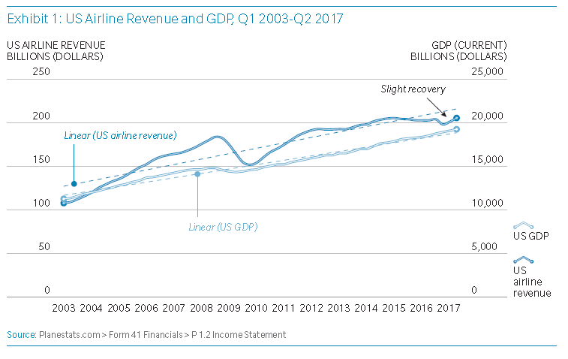
Overview
Since 2003 U.S. Airline Revenue Has Increased at a CAGR of 4.5% versus GDP of 3.8%

Slide 7
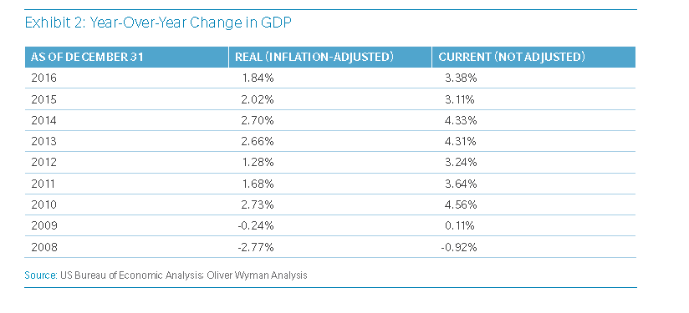
Airline Industry Outgrowing GDP Domestically
Lower Fuel Prices and Better Management of Capacity Have Lead to Increased Profits

Slide 8
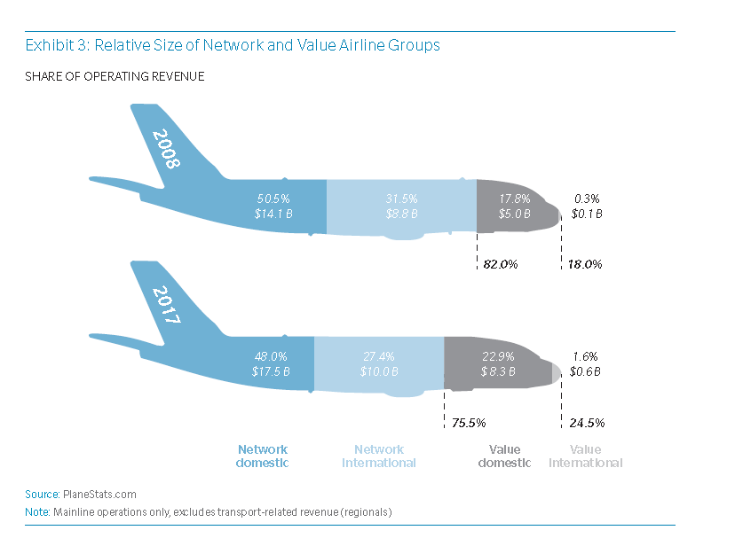
Value Airlines Growing Faster Than Network Airlines
Value Airlines Are Adding Routes and Seats to Increase Revenue and Market Share

Slide 9
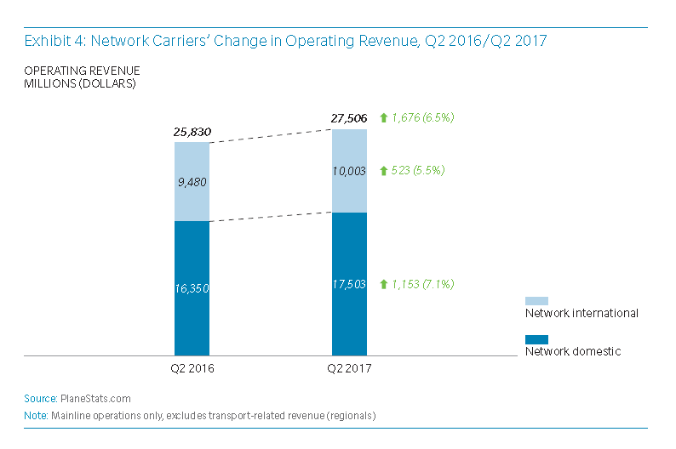
Network Airlines Operating Revenue Performance
Network Carriers Increased Operating Revenue by $1.7 Billion for 6.5% Growth in 2017

Slide 10
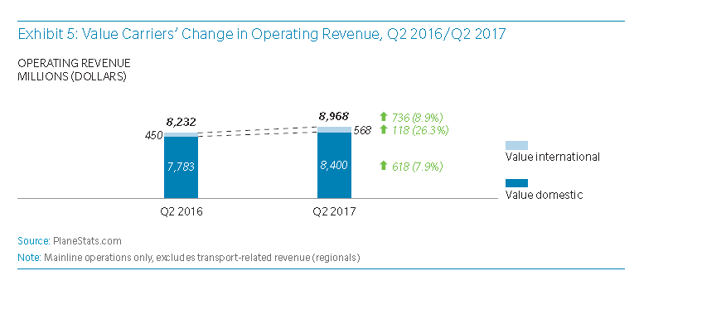
Value Airlines Operating Revenue Performance
Value Carriers Increased Operating Revenue by $736 Million for 9% Growth in 2017

Slide 11
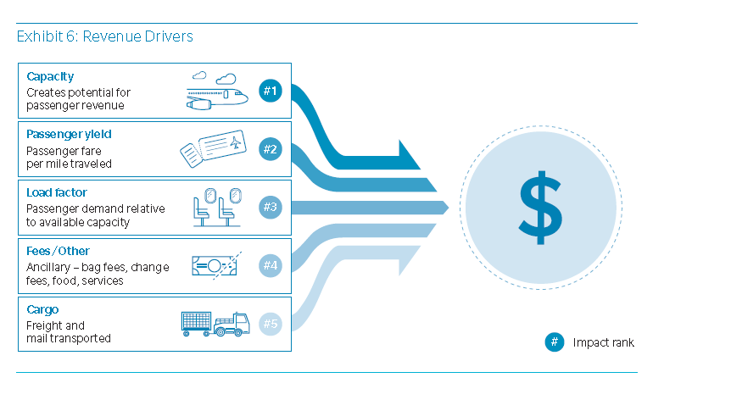
How do the airlines make their money?
Balancing these 5 factors enables the airlines to optimize income far better than cutting rates on landing fees or asking for a bigger cut of non-aeronautical revenue

Slide 12
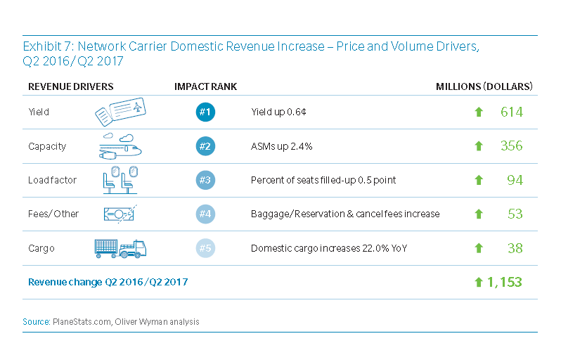
Efficient management means leveraging the right tools?
Airport non-aeronautical revenues play a small part in making airlines profitable

Slide 13
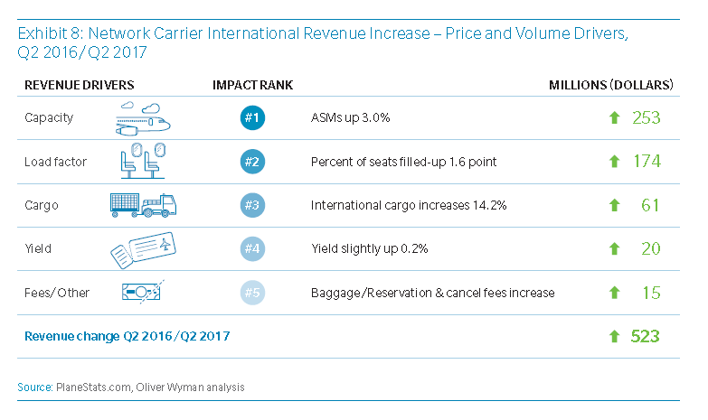
The fundamental management principles are the same
Whether domestic or international flights the math works in a consistent manner

Slide 14
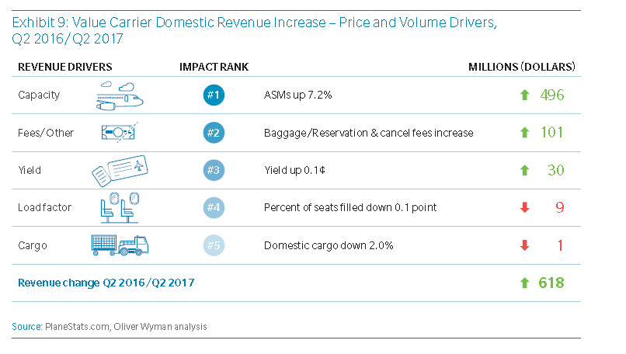
Because “Value” Airlines Have Cheaper Seats
Yield plays a smaller role in profitability than you see in network airlines; fees and capacity become bigger leverage points for “Value” Airlines

Slide 15
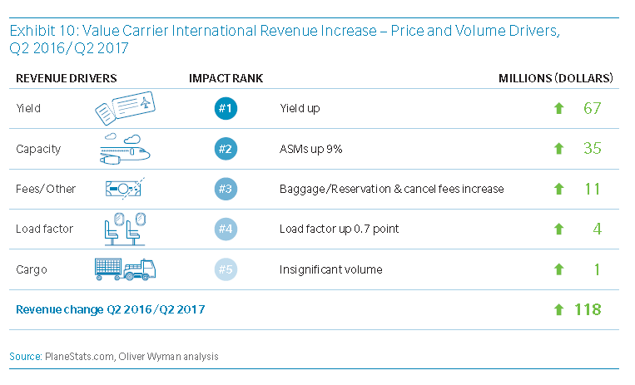
International Flights Display a Different Paradigm for Value Airlines
Value Airlines must manage “yield” harder to be successful on International Flights

Slide 16
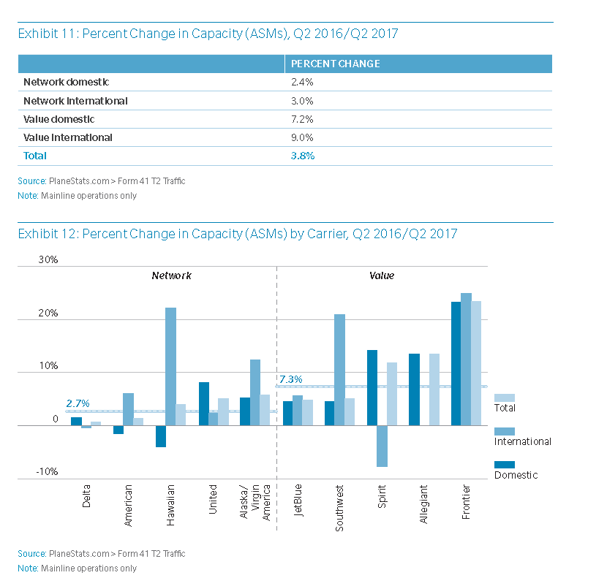
Capacity Management by Airline
The larger airlines are buying fewer planes while smaller airlines are investing heavier in more flights

Slide 17
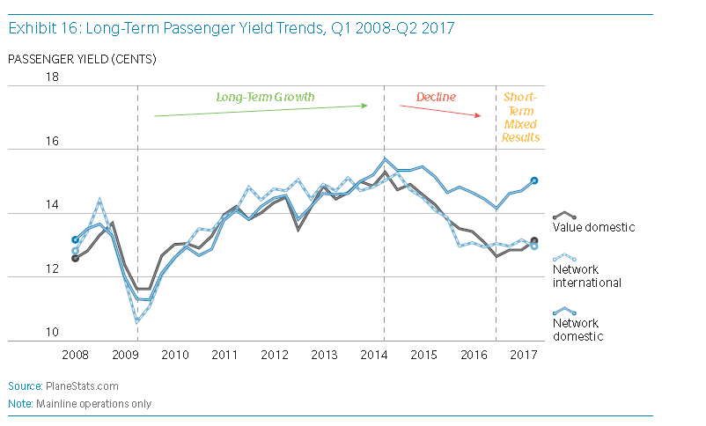
Steady smooth ride seeing rough ride since 2014
Despite 38% increase from 2009-2014 passenger yield fell 12.5% from 2014-16 reaching low of 13.4 cents in 2017 versus 15.5 cents in 2014

Slide 18
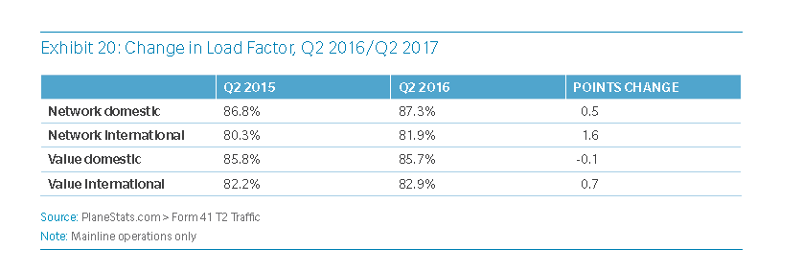
Load Factor Continues at all time highs
Airport support services in security and HVAC have to be at their best with high load factors like these

Slide 19
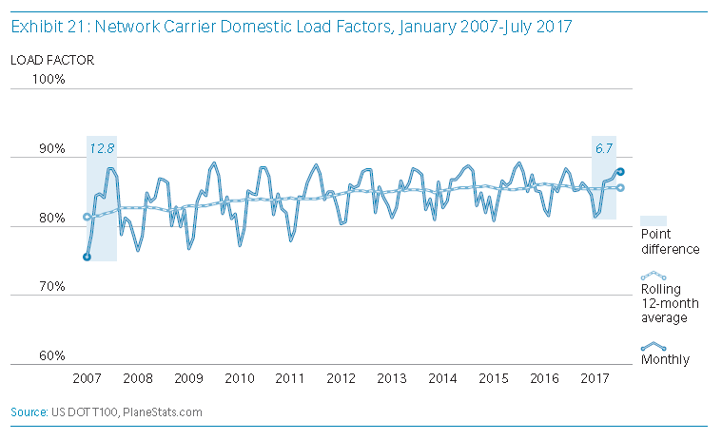
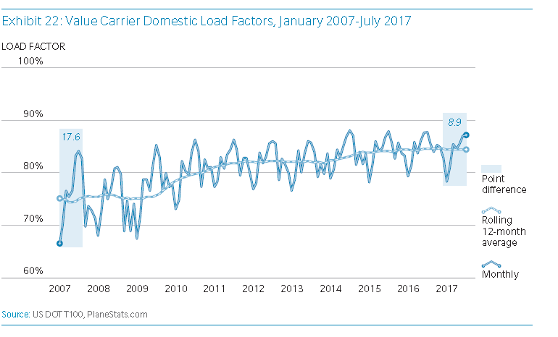
Load Factor Continues at all time highs
High load factors mean airport have to bring their “A” game everyday

Slide 20
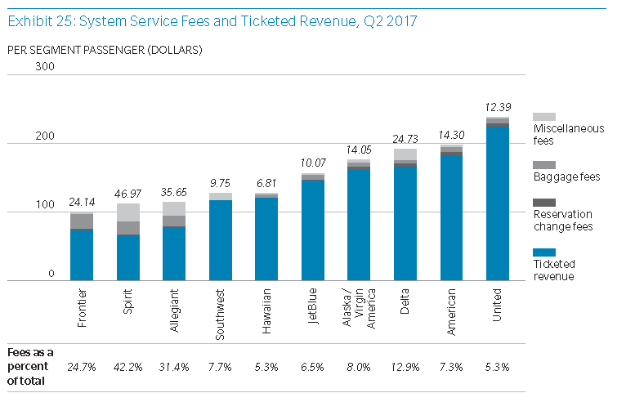
The importance of baggage
Baggage fees are a very big deal for some airlines

Slide 21
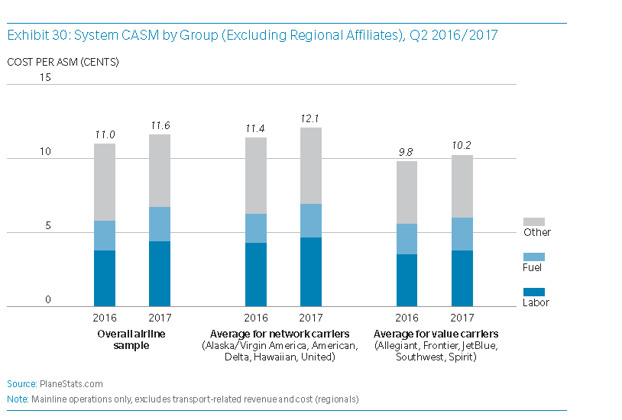
Fuel Cost
Fuel Cost increases have place pressure on rates

Slide 22
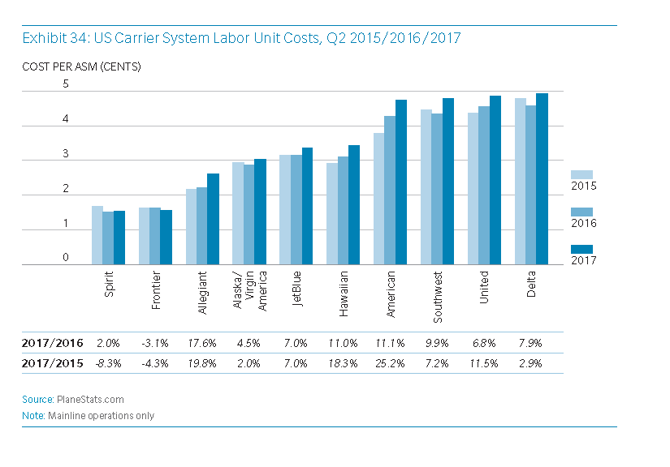
Labor Cost
Labor cost were going up before tax law changes so we can expect more of same

Slide 23
Conclusions
Growth
When airlines do well, airports do well
The last 5 years have been a boom
Implications
Value Airlines growing faster, adding flights
Increased revenues and income prevalent
Airports
Higher load factors mean lower room for airport errors
Demands on facilities, TSA, & roadways will continue to increase as population flying continues to grow
If you sense your airport is already “maxxed-out” now would be the time to re-do your Master Plan and begin planning to expand your facilities

